Slide 1

Promoting a Research Culture in Schools
SERA Leadership in Education Network
25th April 2015
Kenneth Muir
Chief Executive, GTCS

Slide 2
Teachers as researchers
“The resurgence of interest in .... “teacher research” over the last decade is aligned with the popular advocacy of “evidence-based” or “best practice” within public policy communities and specific calls for “teaching as a research-based profession” (Hargreaves 1996)”.
Teachers as researchers: initial experiences within the Scottish “Schools of Ambition” Hulme, Lowden and Elliot (2009)

Slide 3
Teachers as researchers
“From the late 1990s, the development of closer relationships between the practitioner and academic communities has been strongly encouraged across the UK, following criticism of the value and relevance of educational research for both policy makers and teachers”
Teachers as researchers: initial experiences within the Scottish “Schools of Ambition” Hulme, Lowden and Elliot (2009)

Slide 4
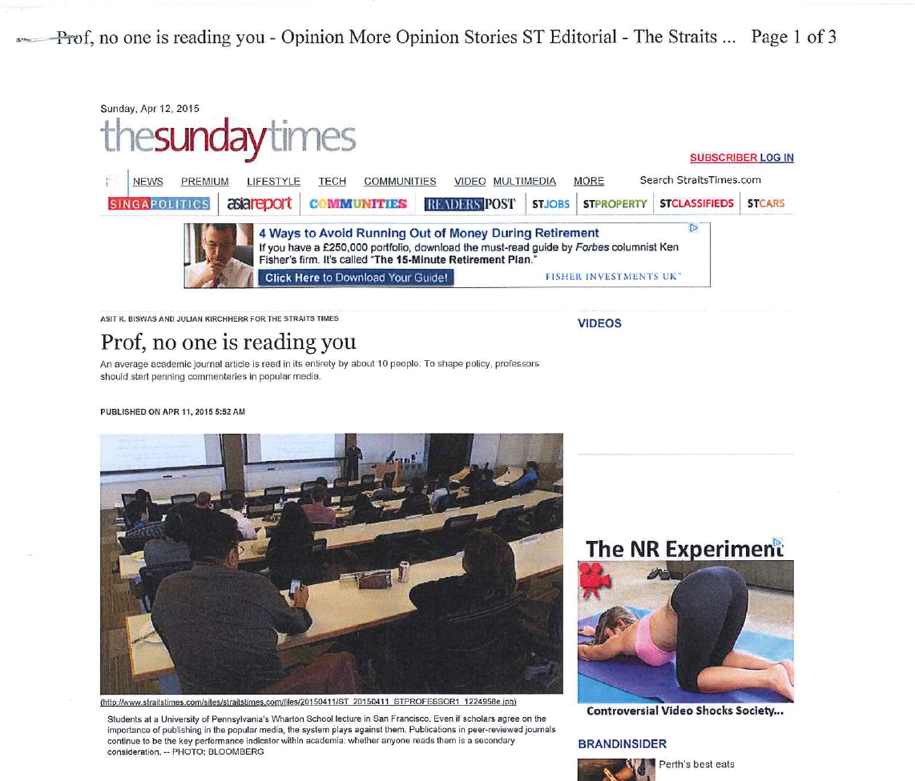
The value and relevance of educational research

Slide 5
Teachers as researchers
“Collaborative enquiry has been associated with the democratising of research relations, the promotion of collegial practices and the encouragement of participatory decision making in schools....
Proponents of teacher research have argued that conventional “outsider” research contributes to the disenfranchisement of teachers....
Teacher research is aligned with a commitment to move from “communities of practice” towards “professional learning communities.”
Teachers as researchers: initial experiences within the Scottish
“Schools of Ambition” Hulme, Lowden and Elliot (2009)

Slide 6
Teachers as researchers
Teachers should be:
“Increasingly expert practitioners whose professional practice and relationships are rooted in strong values, who take responsibility for their own development and who are developing their capacity both to use and contribute to the collective understanding of the teaching and learning process.”
“Teaching Scotland’s Future” 2011

Slide 7
Teachers as researchers
“ The most successful education systems invest in developing their teachers as reflective, accomplished and enquiring professionals who are able, not simply to teach successfully in relation to current external expectations, but who have the capacity to engage fully with the complexities of education and to be key actors in shaping and leading educational change”.
“Teaching Scotland’s Future” 2011

Slide 8
Promoting a Research Culture in Schools
8 schools (4 primary; 3 secondary; 1 special) and 2 colleges
“What are your views on teachers as
researchers?”
“To what extent is engagement with research
actively encouraged in your school/college?”

Slide 9
“What are your views on teachers as researchers?”
“ You’re kidding. I haven’t enough time to do the day job as it is.”
“ I don’t think that’s what teachers do... It’s more for universities to do research.”
“ It depends on what you mean by “research” but if you mean experimenting with things in my class, then I do it every day...it’s how I can improve things. I suppose that’s a kind of research, isn’t it?

Slide 10
“To what extent is engagement with research actively encouraged in your school/college?”
“ You’re kidding.....”
“ We have monthly “learning lunches” at which we focus on a piece of recent research (usually chosen by the HT) and we talk about it.”
“ Colleges don’t do research. Universities do research!”

Slide 11
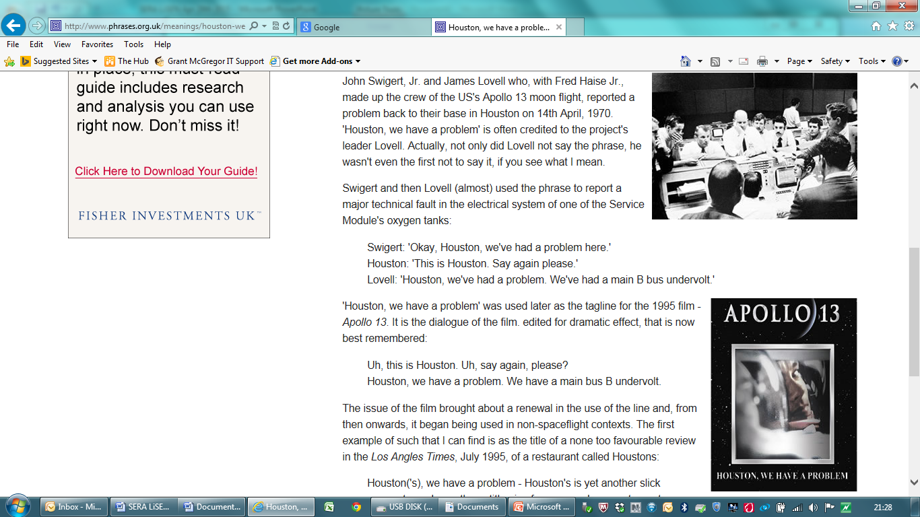
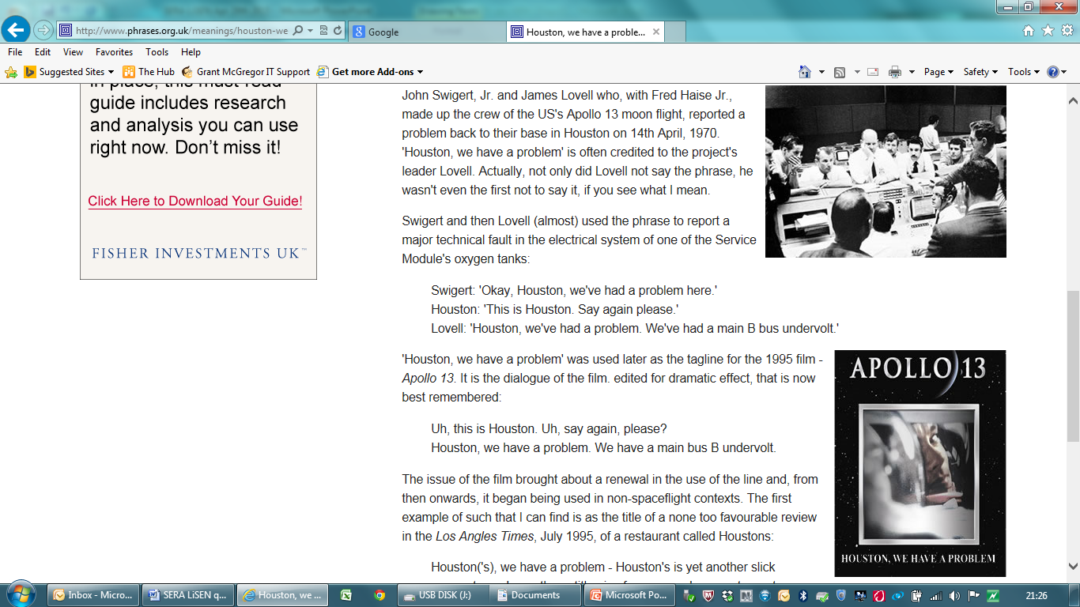

Slide 12
....we have a problem....
Confusion and uncertainty as to what constitutes “research”
Teachers being left to try and understand and make sense of the concept of “teachers as researchers”
Whose role is it to lead (or is it manage?) the promotion of a research culture in schools?

Slide 13
Interpretations of “research”
Academic research
inaccessible; removed from reality; abstract
Applied research reports (research digests and briefings) – helpful as summaries
Research-informed policy texts (policy and guidance documents) - digestible
The “enquiring teacher” – constantly engaging in reflection and “tinkering”
Teachers as researchers: initial experiences within the Scottish “Schools of Ambition” Hulme, Lowden and Elliot (2009)

Slide 14
“The Research Delusion”
Dylan Wiliam
“ The desire for teaching to become a research-based profession is a noble one, but ultimately it will not achieve the result its advocates want.
Instead we need to focus on teacher expertise, of which research is one of many parts. We need to support current teachers to improve their practice and inform their judgement.”

Slide 15

“The Research Delusion”
Dylan Wiliam
“Teachers should seek to improve their practice through careful reflection. They need to explore different ways of meeting the needs of their students and try to evaluate (to the extent that this is possible) whether new approaches are more successful than previous ones.”

Slide 16
“The Research Delusion”
Dylan Wiliam
“ We also need to accept that teachers improve in different ways. Some teachers may wish to share their work with colleagues at conferences or professional development sessions..but...some may feel their time is better spent in other ways. Some may wish to prepare their findings for publication; others may wish to pursue degrees and publish their work in research journals. These are all worthwhile activities with equal footing.”

Slide 17
Interpretations of “research”
Academic research
Applied research reports
Research-informed policy texts
The “enquiring teacher”
“Supporting professional learning
through systematic self-study”

Slide 18
GTCS: Using Professional Standards to support Professional Learning
The Standards for Registration (mandatory, comprising the SPR and the SFR)
The Standard for Career-long Professional Learning
The Standards for Leadership and Management (for middle leaders and Head Teachers)
Professional Skills and Abilities
Professional Knowledge and Understanding
Professional Values (social justice, integrity, trust and respect )
and
Personal Commitment

Slide 19
Professional Standards
“Professional Standards have significant potential to provide the necessary provocation for teachers to think about their work, practice and professional identity in quite fundamentally, different and generative ways.”
Sachs J (2010)

Slide 20
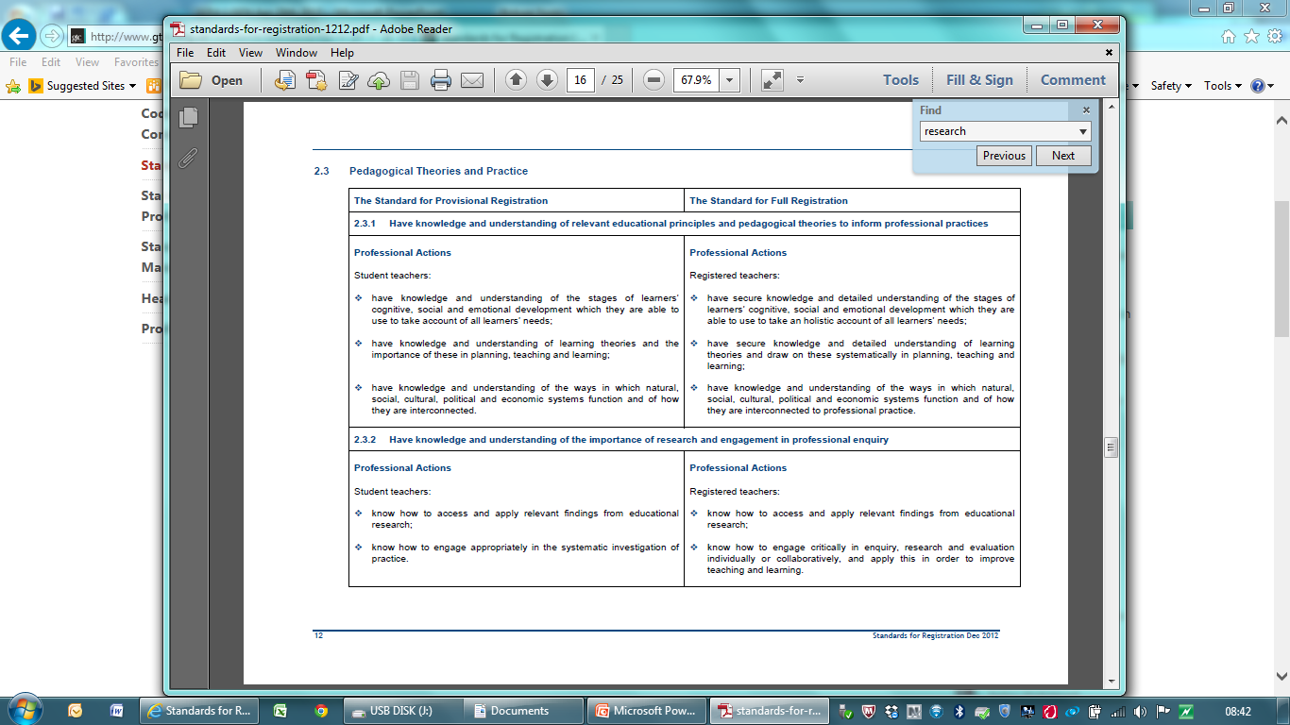
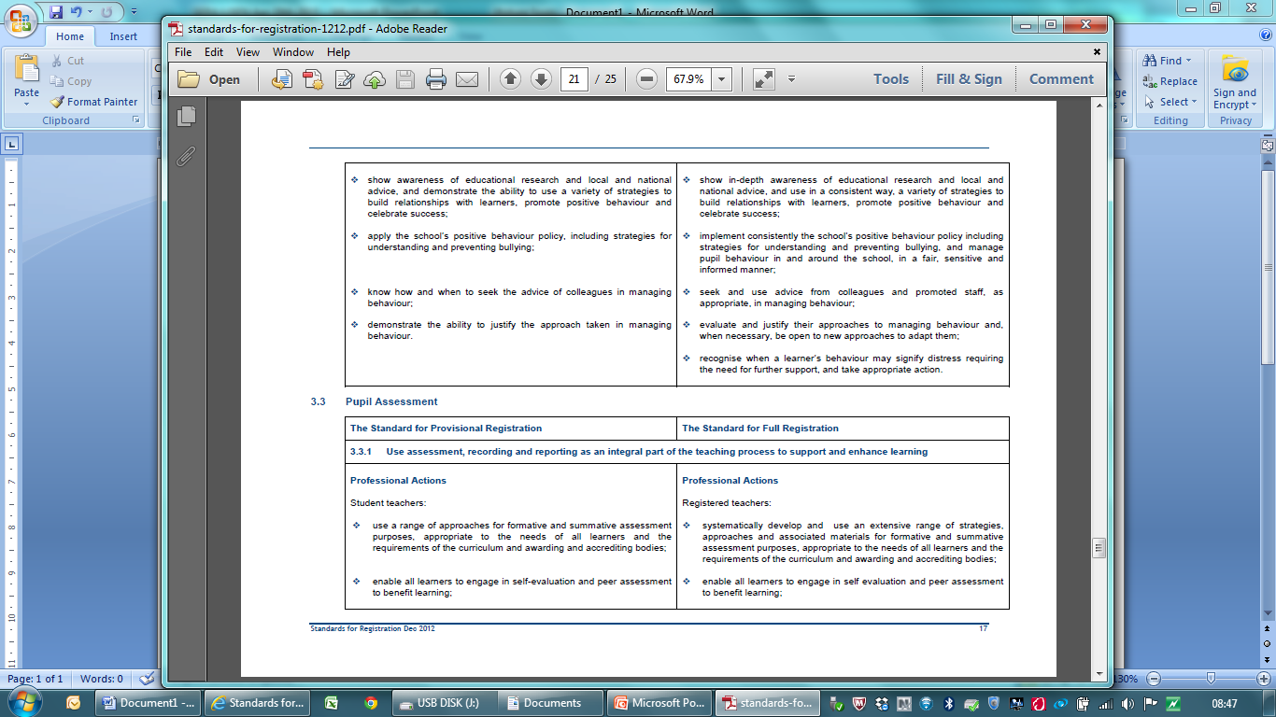
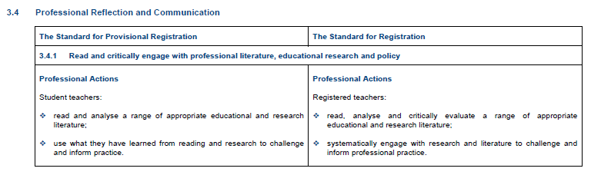
Research and GTCS Standards

Slide 21
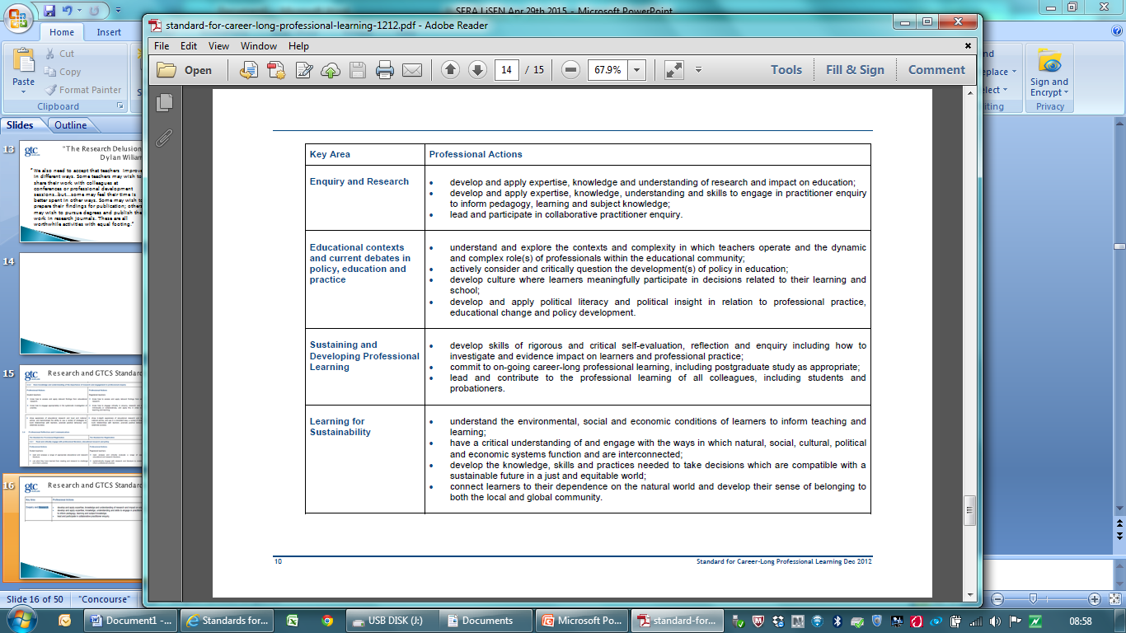
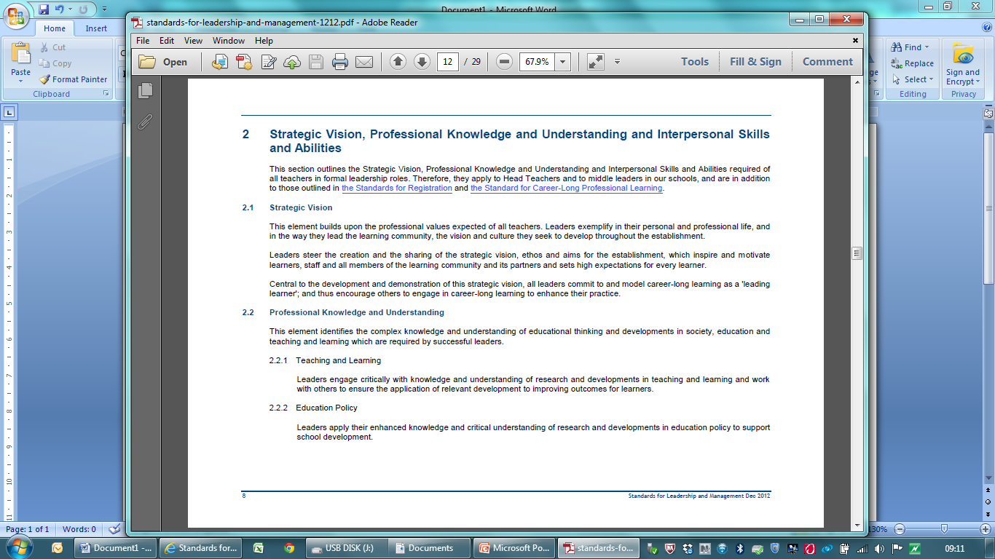
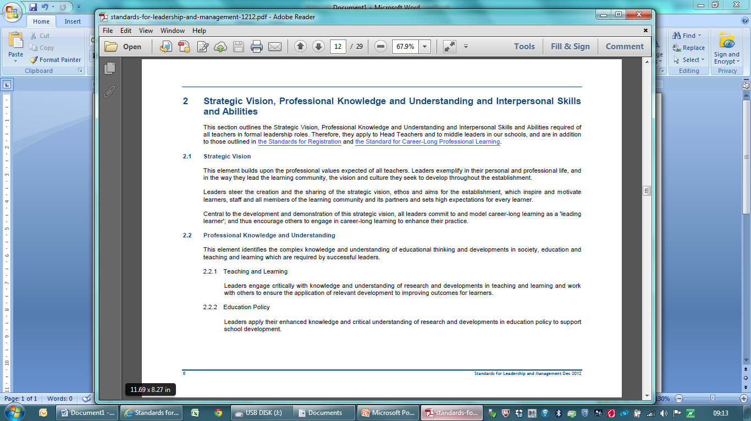
Research and GTCS Standards

Slide 22
Professional Standards and Career-Long Learning
“If Standards are to become the basis for promoting high quality professional learning, they need to be regarded as a series of signposts to guide an integrated professional learning agenda, rather than a series of discrete accomplishments to be ticked.”
Timperley (2011)

Slide 23
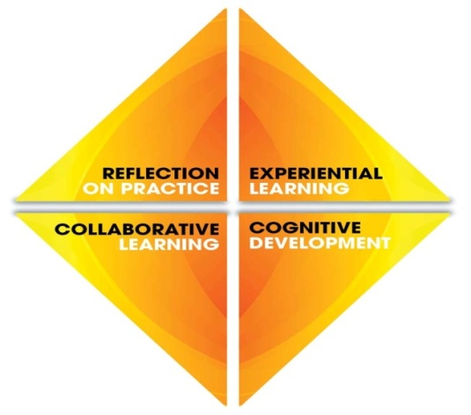
Professional Update
SLM
SFR
SCLPL
SPR
SFR
Provisional Registration
Full Registration (General)
Professional Review + Devt.
ITE
TIS
FR
The Enquiring Professional
Entry Memorandum & Guidelines
Teaching Qualifications
Qualified Outside Scotland
Registration
Dual
Registration
Professional Recognition
Professional Qualifications & Professional Registration

Slide 24
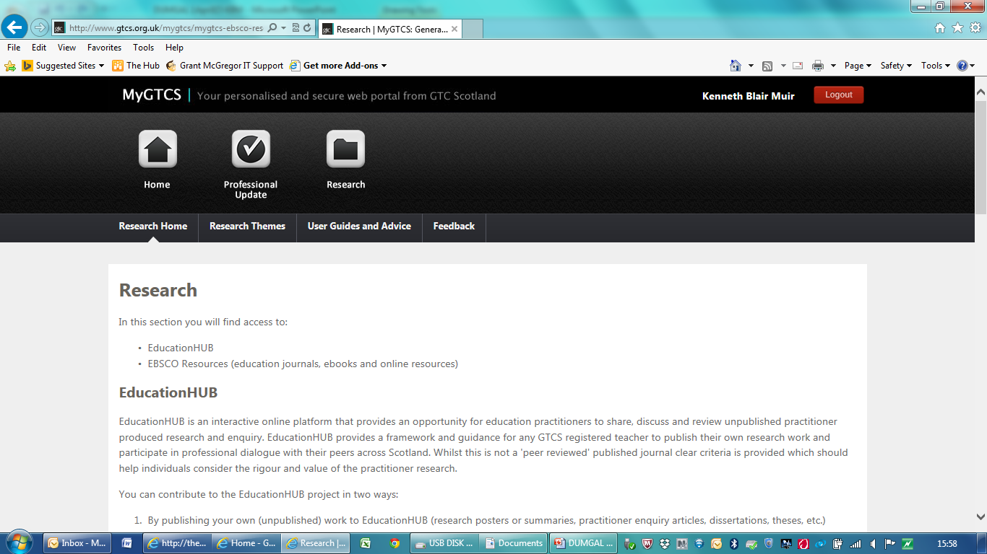
GTCS:
Supporting Professional Learning
EBSCO – online access to 1700 educational journals + e-books
Research Engagement Group – developing and trialling teacher engagement with EBSCO
Education Hub

Slide 25
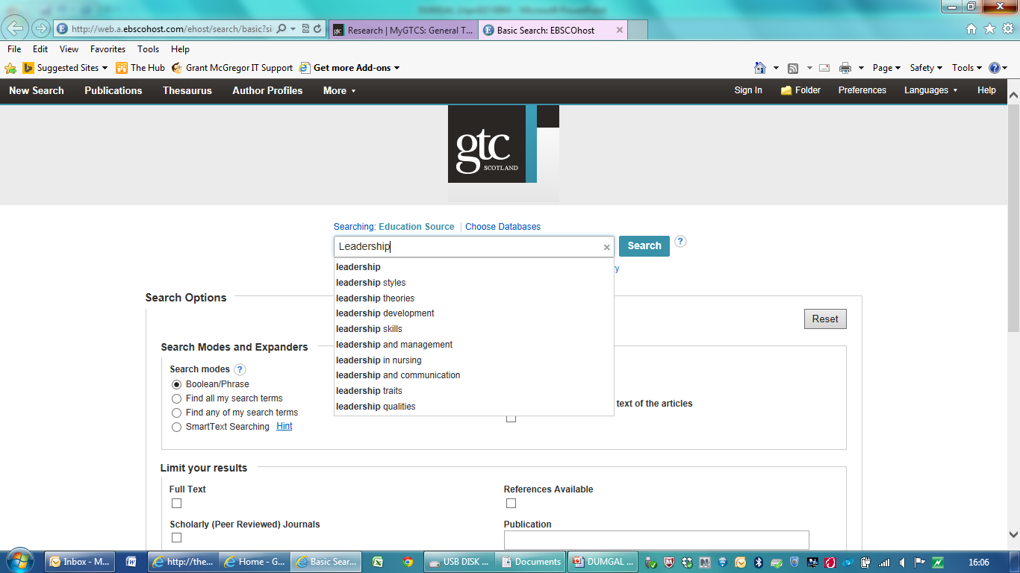
EBSCO

Slide 26
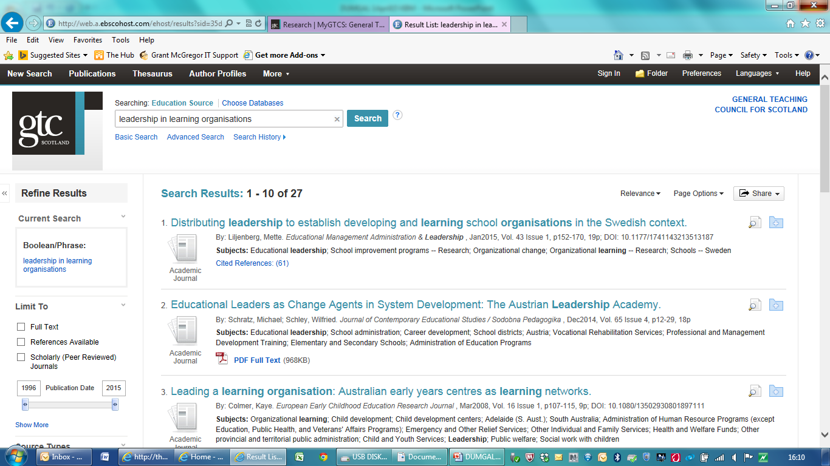

Slide 27


Slide 28
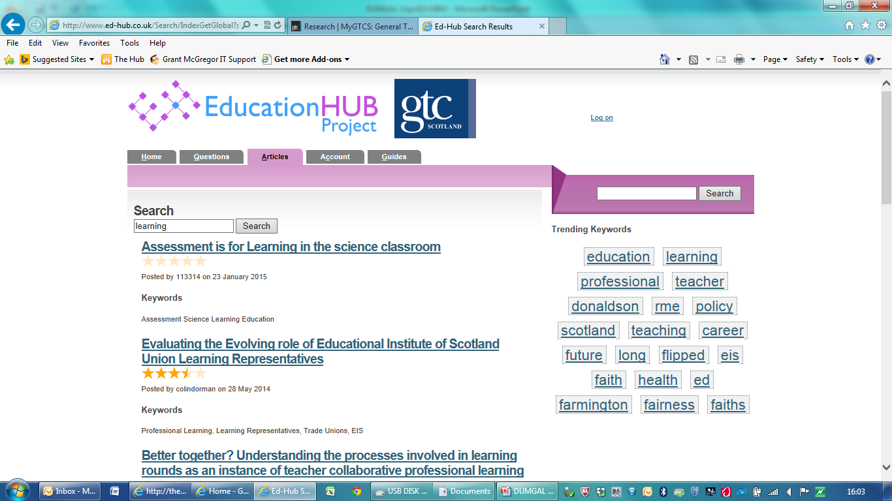

Slide 29
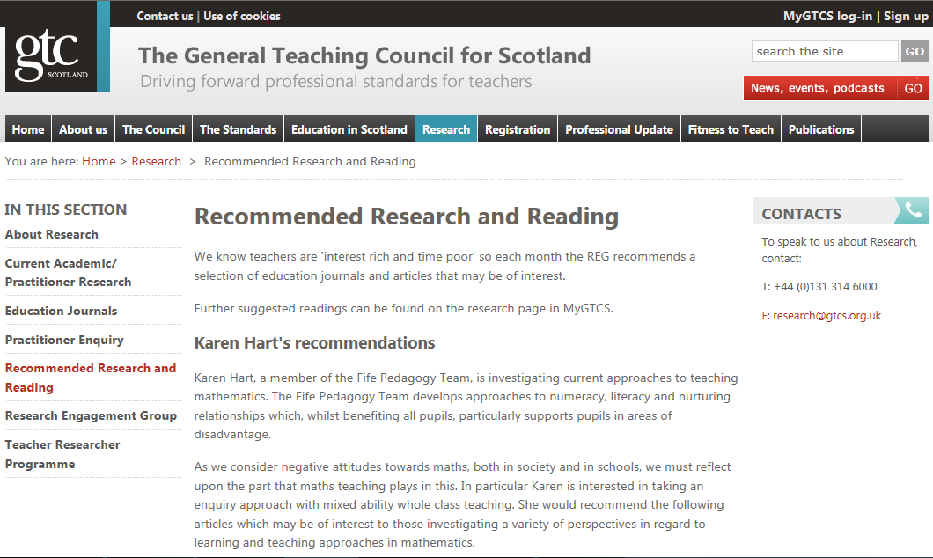
Recommended Research and Reading

Slide 30
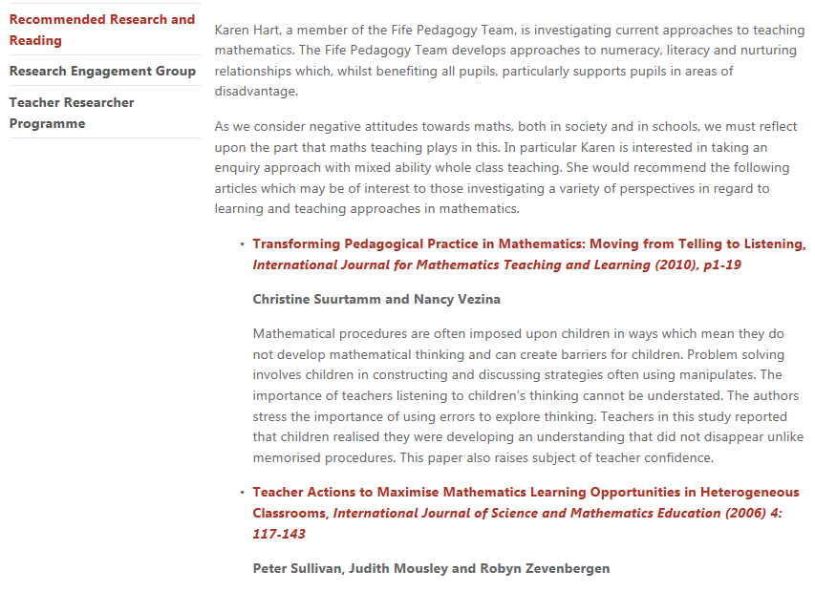

Slide 31
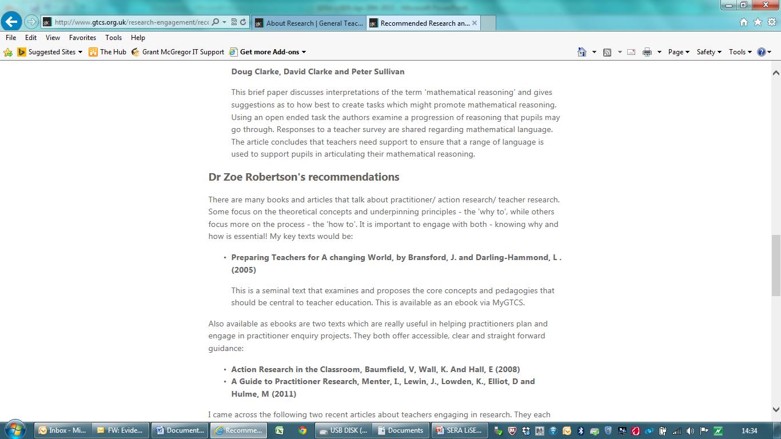
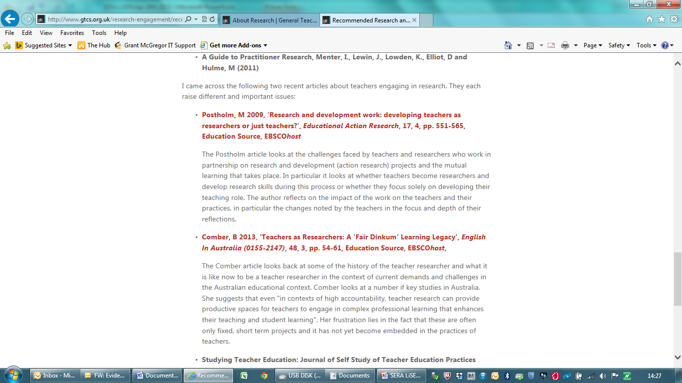

Slide 32
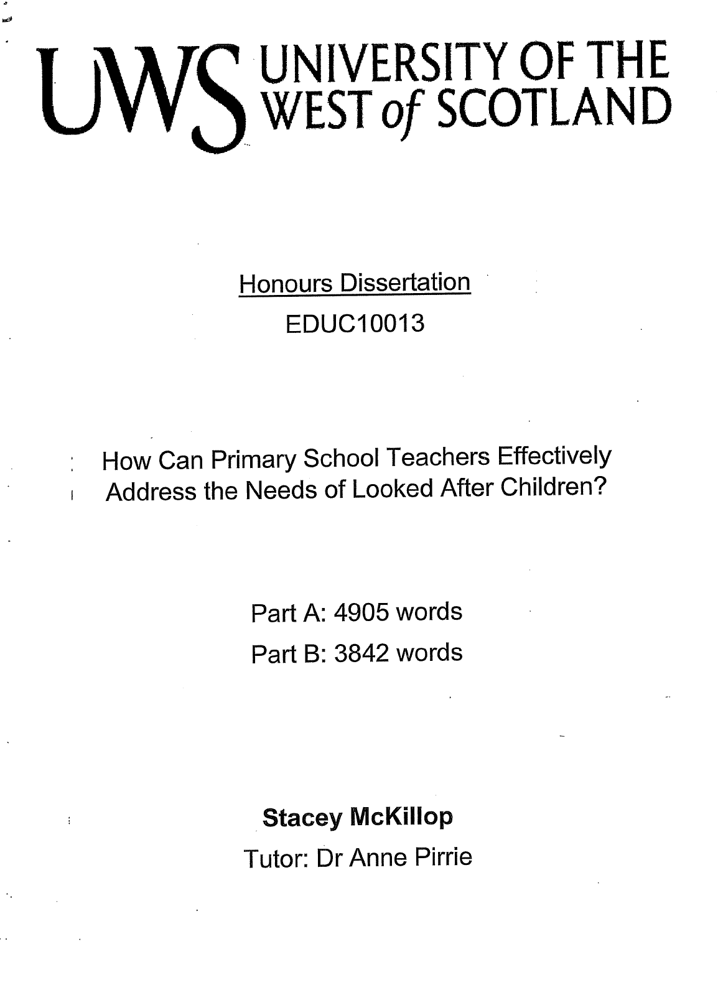

GTCS: George D Gray Award

Slide 33
GTCS: Supporting Professional Learning through Professional Update
Self-evaluation and critical reflection processes
Experiential, action or enquiry-based learning
Professional dialogue with colleagues, other professionals, parents, and learners
Focused professional reading and research
Leading or engaging in practitioner enquiry/action research
Critical analysis of reading, learning and impact on professional practice
Learning about aspects of the curriculum or pedagogical practice
Peer support e.g. coaching or mentoring
Classroom visits/peer observation
Online learning/blogs

Slide 34
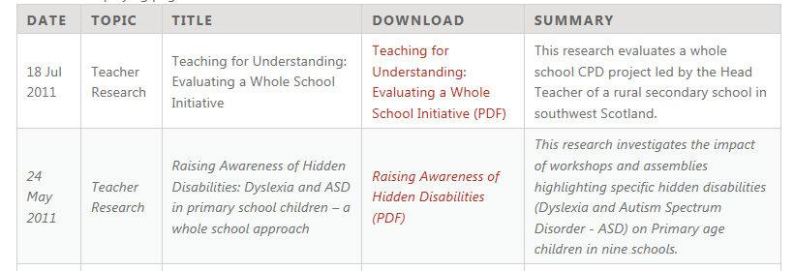
GTCS:
Supporting Professional Learning
Teacher Education Teachers' Work Workshops
The Teacher Education Teachers’ Work (TETW) Research network: a partnership between the University of Strathclyde and the University of Glasgow with the GTC Scotland.
Teacher Researcher Programme

Slide 35
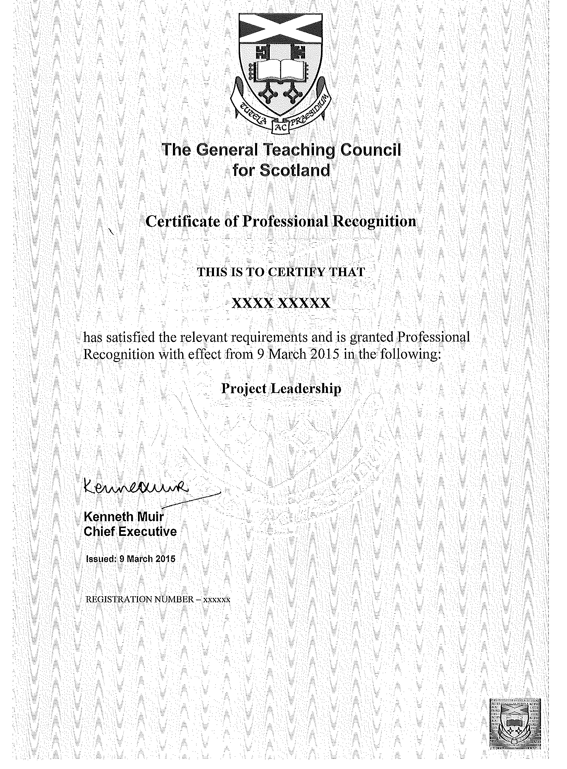
GTCS: Supporting Professional Learning through Professional Recognition
Professional Recognition provides
the opportunity for those who are
fully registered with the GTCS and
have completed one year of
professional practice to focus
on and develop their
professional learning in
particular areas of expertise
and gain recognition for
enhancing their knowledge,
understanding and practice.

Slide 36
Examples of successful PR applications
Developing education for global citizenship
Supporting Pupil Learning: The Reflective Thinking Programme
Education and care of children and young people on the autistic spectrum
Leadership: Improving attainment of lowest performing 20%
Outdoor Learning: Duke of Edinburgh Awards Scheme

Slide 37
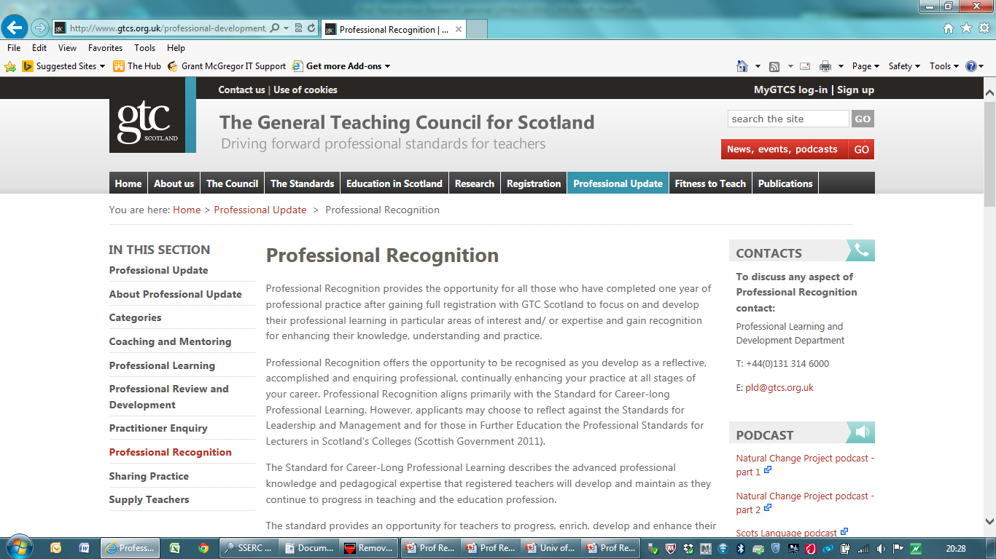

Slide 38
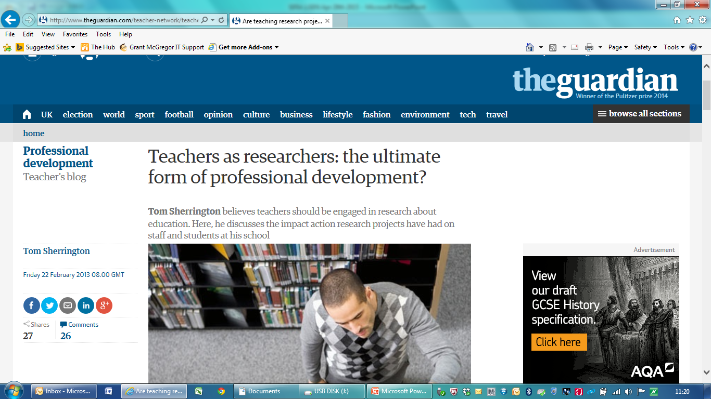

Slide 39
Questions
What constitutes a “research culture” – what might it look like?
How can national bodies and the research community best support teachers to access, communicate, use and interpret research?
How do we ensure that educational and leadership research is of value and relevance for both policy makers and practitioners?
How do we best foster collaborative approaches to the development of research into leadership and leadership development?

Slide 40
GTC Scotland
ken.muir@gtcs.org.uk
Twitter @GTCSKen

